Slide 1
Design Plan
Team: JAK-EE chan
Members: Jeremy Doll, Ahmad Mostafa, Keil Toso

Slide 2
1. Problem Statement
Wireless speakers using Bluetooth for communication have become widely available in the past few years.
However, few provide any type of visual stimulation such as lights.
Speakers with more extensive lighting are excessive and not suited for calmer environments.
Users have little to no control over the lighting.

Slide 3
1. Problem Statement
Team JAK-EE chan saw the practicality and usefulness of Bluetooth speakers, and found inspiration from lighted speakers on the market.
However, the team hoped to create something that is more visually stimulating but not over-the-top, and which also allows user-input.
Such speakers could be a great option for people who enjoy lights with music in calm or exciting settings.

Slide 4
2. Proposed Solution
The solution is a set of portable, wireless speakers with LED’s strips that light with different audio frequency ranges.
Users can select the color of the LED strips.
Three LED strips: one associated with bass frequencies, another with middle-range frequencies, and another with treble frequencies.
LED’s are bright and noticeable in darker environments, but not overbearing in lighted areas.
Speakers can be carried and moved by one person.

Slide 5
2. Design Goals (Requirements Specification)
The system shall output audio selected from Bluetooth-capable devices to two speaker drivers.
The system shall illuminate three LED strips consisting of 50 LED’s each, in at least three possible colors.

Slide 6
2. Performance Parameters (Requirements Specification)
Attribute | Specification
Battery | Rechargeable, polymer Lithium-Ion: 1000mAh, 3.7V
Run-time | 2 hours minimum before battery needs to be re-charged
Size | No larger than 36in x 36in x 36in
Weight | No more than 10 lbs
LED Supply Voltage | 12V

Slide 7
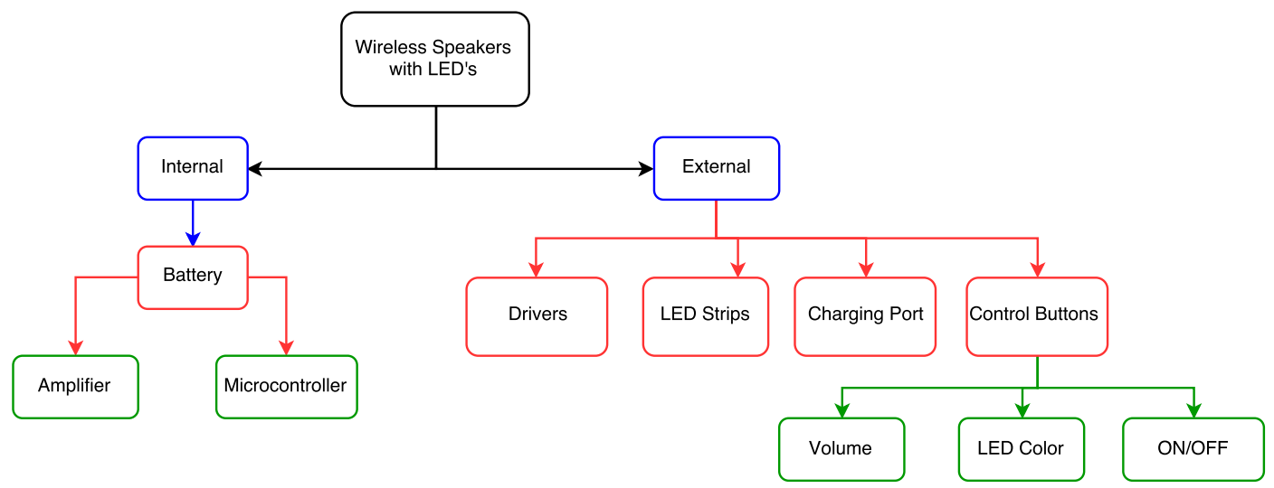
3a. Block Diagram: Speaker Design

Slide 8
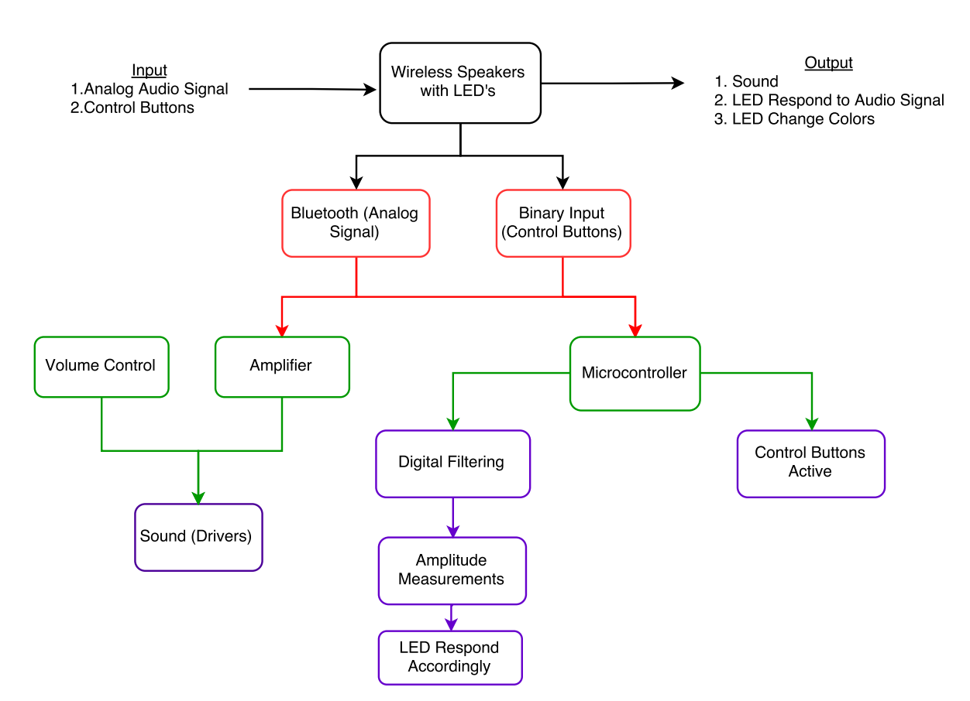
3a. Block Diagram: Implementation

Slide 9
3a. Printed Circuit Board (PCB)
Components:
Voltage regulation
Power amplifier
Boost converter
Audio conditioning circuitry
To understand how to design and construct a PCB:
Review EE 200 notes
Research from external sources

Slide 10
3b. Technical Details: Hardware
The chassis of the speakers will be either:
Made from scratch, using plastic or wood.
Constructed from a pre-existing container, and adjusted to requirements.
The LED strips will be attached to the outside of the speakers.
Connected and powered internally.
Power distribution for the system must be taken into consideration because each separate component has a minimum and maximum allowable voltage.
A battery will be inserted inside the system.
A charging circuit is required to re-charge the battery.
Multiple voltage regulator circuits will be implemented to account for each component.
Internal organization
The placement of internal components will be confined but with all parts accessible.
This will conserve space.
It will also make it easier to replace components in the future if needed.
Every element of the system must be securely placed to prevent damage from unwanted movement.
Microcontroller Function
The Teensy Audio Adapter board will convert the analog signal from the
Bluetooth module to a data stream readable by the Teensy 3.2.

Slide 11
3b. Technical Details: Software
Producing sound from the speakers:
Signal from audio source will be captured by Bluetooth module.
The analog signal will be sent to a boost amplifer and output to the drivers.
To control volume, a potentiometer will be placed between the amplifier and the drivers.
This enables the raising or lowering of the output signal level.
Most of the software development will deal with the LED strips.
Three LED strips light up with the bass, treble, and midtone frequencies.
The Teensy 3.2 microcontroller will be used to achieve this:
The audio signal being captured by the Bluetooth module will also be sent to the audio adapter board, and then to the microcontroller.
Signal will be analyzed in the frequency domain using an FFT.
Digital filters are applied to split the frequencies into three separate ranges.
Through trial and error, the proper frequency ranges will be selected.
If the amplitude of a specific frequency passes a selected threshold, then the corresponding LED strip will illuminate.
The rest of the software design will deal with controlling the LED colors.
When a button is pushed, it will send a binary signal to the microntroller.
Depending on which button is pressed, the microcontroller sends a corresponding signal to select a particular color.

Slide 12
3c. Manpower
Jeremy
Interface between Bluetooth-capable device and Bluetooth module.
Implement audio filters to trigger the LED strips.
Program the user selection of LED colors.
Ahmad
Assemble list of required parts and order the parts.
Design power, audio conditioning, and voltage step up/down circuitry.
Realize PCB layout and submit to prospective company.
Keil
Program communication between Bluetooth module and microcontroller.
Solder components to completed PCB board.
Design and build speaker casing.

Slide 13
3d. Schedule
Date | Task
1/11 | Begin Class
1/13 | Choose Groups
1/20 | Complete Project Statement
2/1 | Complete Design Plan
2/3 | Finalize part choices
2/5 | Order all components (excluding PCB)
2/16 | Milestone 1- Bluetooth connected with microcontroller
2/29 | PCB design finalized and submitted
3/2 | Design Review- Power circuit realized with chosen battery/ LED’s installed
3/16 | Milestone 2- LED equalizer realized
4/6 | Milestone 3- Working model fitted inside speaker casing
4/27 | Final Review- Bluetooth Speaker with LED capabilities finished

Slide 14
3e. Cost Estimate
Category | Description | Quantity | Unit Cost ($) | Total Cost ($)
Speaker Chassis
 | Plastic/Wood | 13.5 ft² | 0.42 /ft² | 5.67
 | Bolts | 10 | 1.00 | 10.00
 | Screw Driver | 1 | 5.00 | 5.00
 | Tactical Switch | 1 | 3.00 | 3.00
 | Tactical Buttons | 3 | 0.50 | 1.50
 | Potentiometer | 1 | 2.00 | 2.00
Electronics
 | Teensy 3.2 Microcontroller | 1 | 19.80 | 19.80
 | Audio Adaptor Board | 1 | 14.25 | 14.25
 | Boost Amplifier | 1 | 4.00 | 4.00
 | Bluetooth Module | 1 | 20.00 | 20.00
 | Drivers | 2 | 30.00 | 60.00
 | Printed Circuit Board (PCB) | 30 in² | 5.00 /in² | 150.00
 | LED Strips | 1 | 25.00 | 25.00
 | Battery | 1 | 9.95 | 9.95

Slide 15
3e. Cost Estimate (cont.)
Testing Equipment
 | Function Generator | 1 | 1,000.00 | 1,000.00
 | Power Supply | 1 | 400.00 | 400.00
 | Oscilloscope | 1 | 2,000.00 | 2,000.00
 | Multimeter | 1 | 100.00 | 100.00
Miscellaneous
 | Breadboard | 1 | 10.00 | 10.00
 | Passive Components | N/A | N/A | 22.00
 | Shipping & Handling | N/A | N/A | 25.00
Engineering Work
 | Labor (20 hours/week) | 300 hours | 80.00 | 24,000.00
 | Overhead (20 hours/week) | 300 hours | 80.00 | 24,000.00
Total Cost ($) |  |  |  | 51,887.17

Slide 16
4. References

Slide 18
